Slide 1
Using Machine Learning methods for Geogenic Radon potential Mapping in Hessen
Research Proposal
Master’s Thesis
By: Augustine M Gbondo
TropHEE

Slide 2
Contents
About Me
Introduction
Radon and Health
Summary of Previous work
Research Objectives
Data and Methods
- Data processing
Model selection and performance metrics
Modelling strategy
Comparing packages between R & Python
Targeted Outcome of the study

Slide 3

About Me
Nationality – Sierra Leonean
TropHEE Student at TU Darmstadt
One and half years experience with Python
-Data Analysis
Project: Evaluation of high-resolution meteorological and aerosol data from automated measurements in the Arctic (Eiði, Faroe Islands)
-Data Science
Project: Needs analysis and water allocation mapping from WP_SL survey data
GIS/ML and Hydro informatics

Slide 4
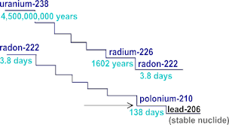
Introduction
3 naturally occurring (Rn) isotopes.
-219 Rn (actinon), 220Rn (thoron), and 222Rn, (Radon),
Produced by radio-decay of 226Radium
Uranium is removed through weathering, but Radium remains insitu (Appleton, 2007)
Originated from granitic and Uraniferous metamorphic rocks
Sandstones, limestones, phosphatic and organic shales are also host rocks. (Appleton, 2007)
Often found in planar discontinuities
Transport by diffusion transport in gas/water carrier fluids
Usually measured as Becquerel per m3/litre (Bq/l) or (Bq/m3)
Where 1 picocurie [pCi] = 0.037 becquerel [Bq]

Slide 5
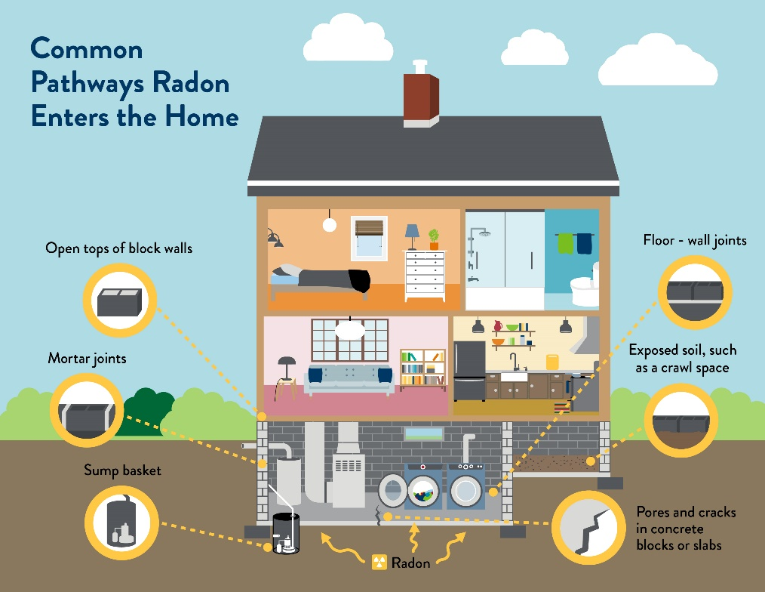
Radon and Health
222Rn - air pollutant, carcinogenic and detrimental on human health (e.g.WHO (2009))
Generally, people receive the highest exposure to Rn indoors, i.e. in homes and at workplaces.
In Germany, the number of lung cancer deaths p/a by residential Rn was estimated with ~1900 (Menzler et al., 2008)
Geogenic radon; natural e.g in rocks. geology, soil properties, and hydrology,
Exceedance limit in Germany is 300 Bq/m3 (bfs.de)
https://www.health.state.mn.us

Slide 6
Summary of previous work
Defining a regional Randon Index
Geogenic Rn hazard index (GRHI) in 2010 for harmonization of regional maps in Europe (EURAMET & MetroRADON project )
Difficulty in Harmonizing maps since different predictors were used
- Geogenic approach: weighted mean
- Optimal approach; best predictor
GRP = Soil Radon conc. X soil perm.
GRP strong predictor of IRC
Mapping of GRP in Germany
- Geostatistical method producing a 10x10Km Map (Bossew, 2015)
ML Applications in Randon.
Rest of Europe
Ensemble regression trees for predicting indoor Rn concentration in Switzerland (Kropat et al., 2015),
neural networks for Mean IRC in the Czech Republic (Timkova et al., 2017)
Time-series analysis (Torkar et al. (2010), Janik et al. (2018)).
Germany
Mapping GRP (Peterman et. Al, 2020 )
Mapping Indoor GRP by Logistic Regression (Peterman & Bossew, 2021)

Slide 7
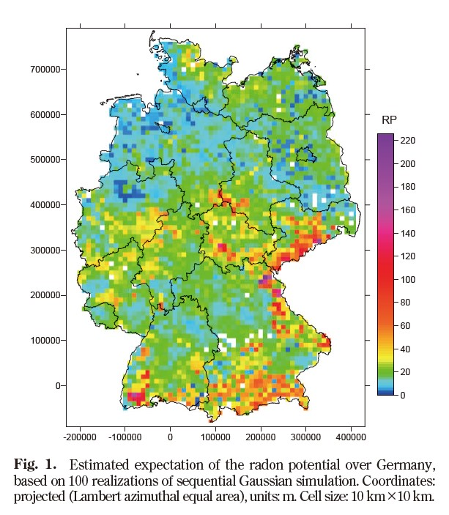
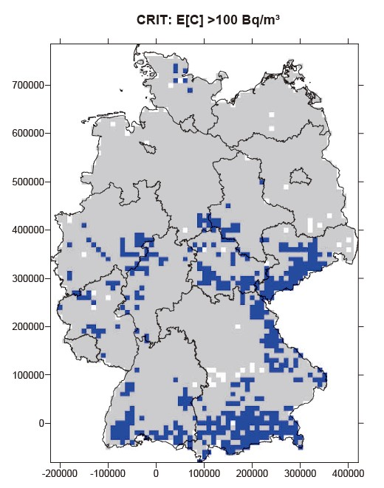
Previous studies
Bossew (2015)
(GRP and Randon Prone Areas (RPA) for effective resource allocation)
Actual (IRC) is a factor of GRP and anthropogenic factors
Geostatistical method
Statistic related to IRC exceeds a threshold, mean or spatial mean
-Mapping the geogenic factor
Geological normalization of the GRP data, interpolated and plotted in Surfer
RPA map based on areas >100 Bq/m2
Outlook: Clustering technique of Geology, merging or sub-divisions
(Bossew, 2015)

Slide 8
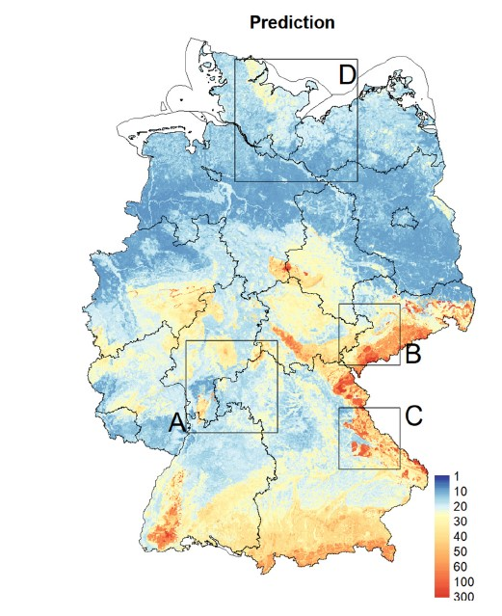
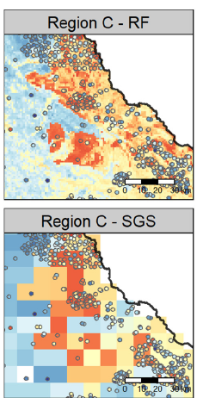
Previous studies
Peterman et. al (2020)
4400 measuring points. (1990–2003)
A Machine learning approach
MARS (Multivariate adaptive regression splines ), SVM and Random Forest (best model)
Input parameters
Geology, soil(physical-chemical & hydr. Properties, Uranium content and Climate
Result: Geology, winter temperature, Hydraulic conductivity are important predictors
More field data and better geological map and implement deep learning techinques
RF model shows more details
(Bossew, 2015)

Slide 9
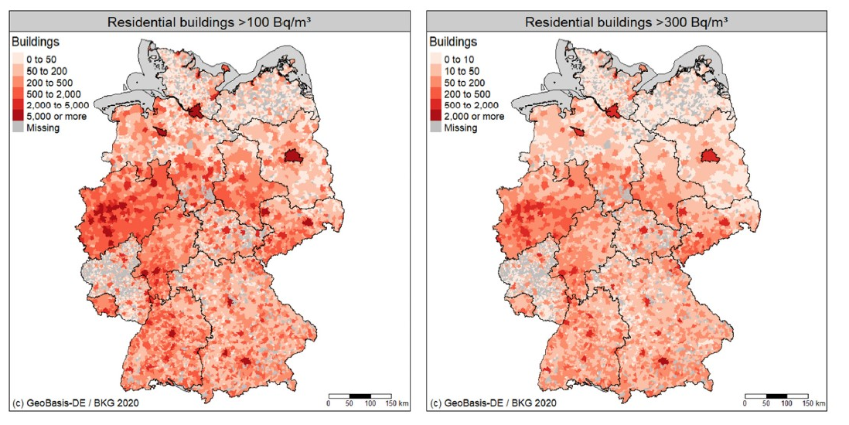
Previous studies
Peterman & Bossew (2021)
(Mapping Indoor Rn )
Geological map 1:250 k instead of 1:1m
Data on residential buildings, 1:250,000 and normalized for house basement and average hazard (exceedance probability)
Modelled IRC as a function of GRP via a Logistic Regression model
P(E) that IRC exceeds 100 or 300 Bq/m3,
Results showed 350k (1.9%) of the 17.8mi residential buildings with over 300 Bq/m3
Peterman & Bossew (2021)
Model (left) is more accurate

Slide 10
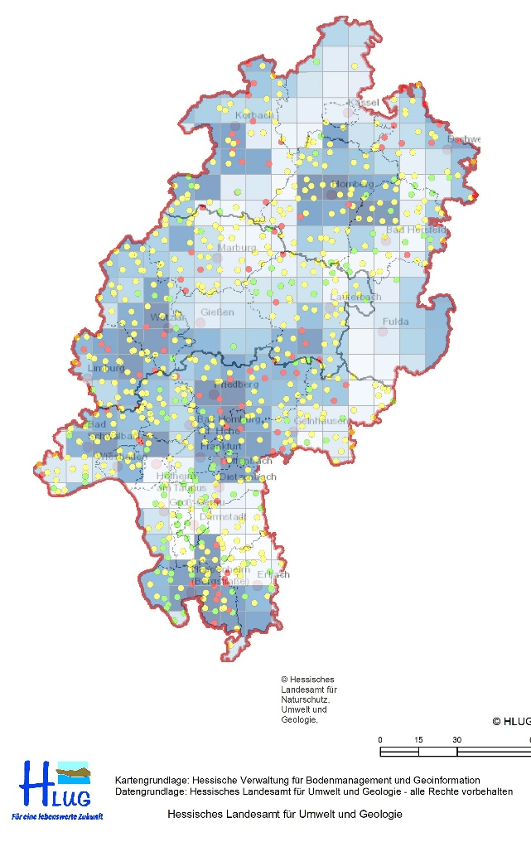
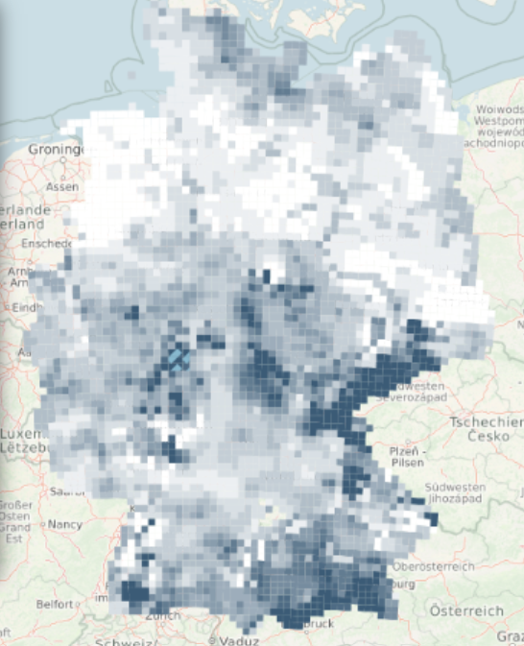
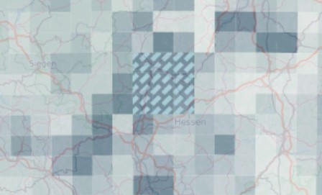
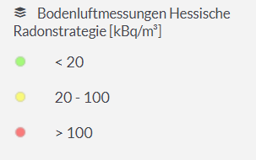

Research Objectives
GRP Mapping of Hessen with a finer spatial resolution
Best ML model for predicting GRP in Hessen
Effect of a lineament Map and high-resolution Geology Map on predicting GRP in Hessen
Bfs.de
Marburg, Lollar, Allendorf.. Showed anomalous readings
Resolution= 1x1 km
Geologie hessen.de

Slide 11
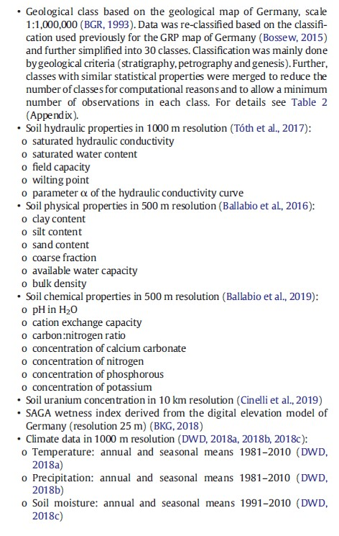
Data and Methods
Field Data
(GRP data)
normalized based
on seasons
Large effect of winter T
(Peterman et al, 2020)
Predictor Data
1:25,000 Geological Map
Lineament Map
Strong effect on GRP (Mollo 2022; Sukanya · 2021)

Slide 12
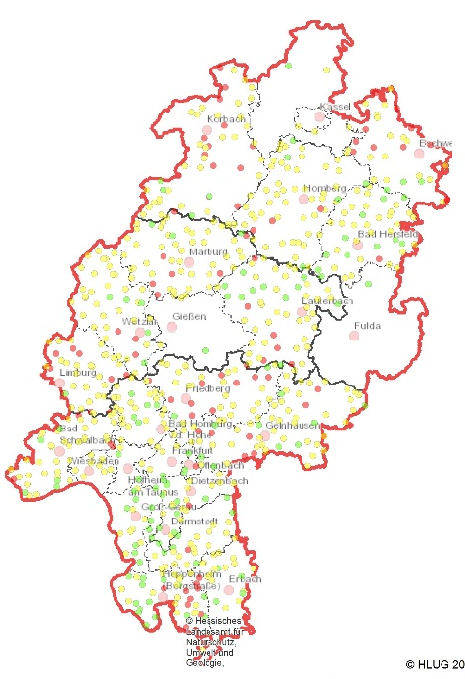
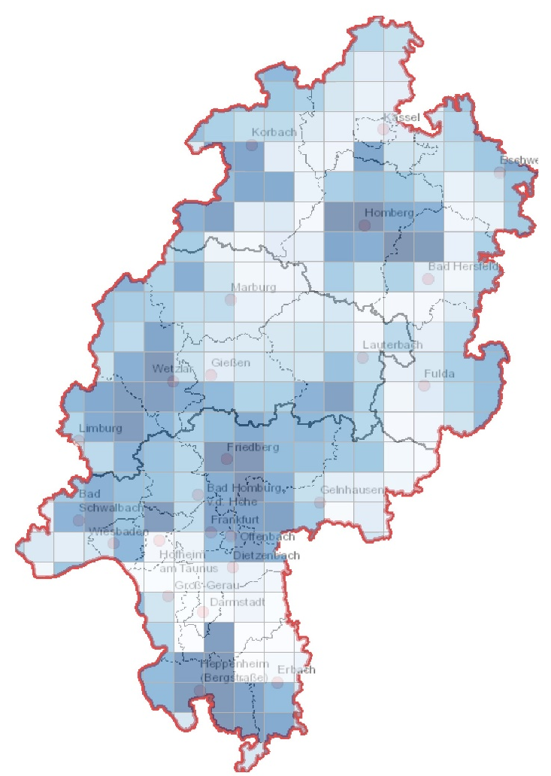

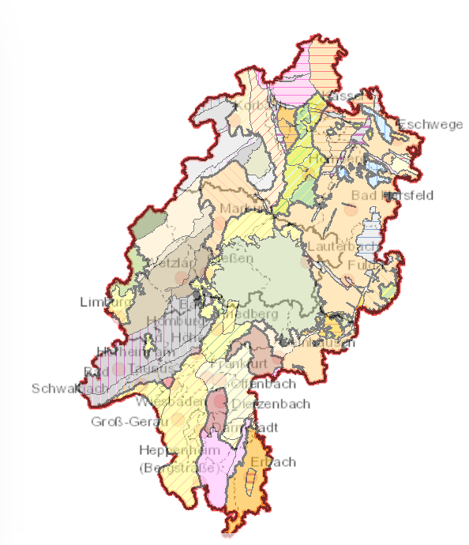
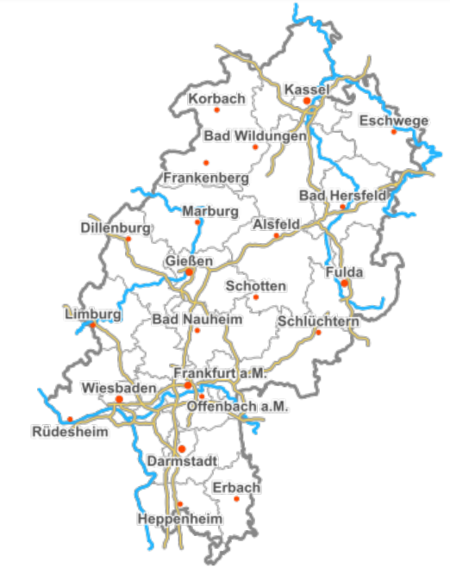
Data and Methods
Field data
Updated
Correction factor
Environmental co-variables
- Geology, soil, climate etc.
ML Model
GRP Map of Hessen

Slide 13
Data Processing
Measured/Field data
Exploratory Data Analysis and cleaning
Handling missing data
Detecting and filtering unwanted outliers
Handling of missing data
Tools : Xcell, python
Predictor Data
Geological map, soil maps, climate
Geo-reference or digitize where necessary
Resampling where necessary
Feature extraction
Tools : ArcMap, python

Slide 14
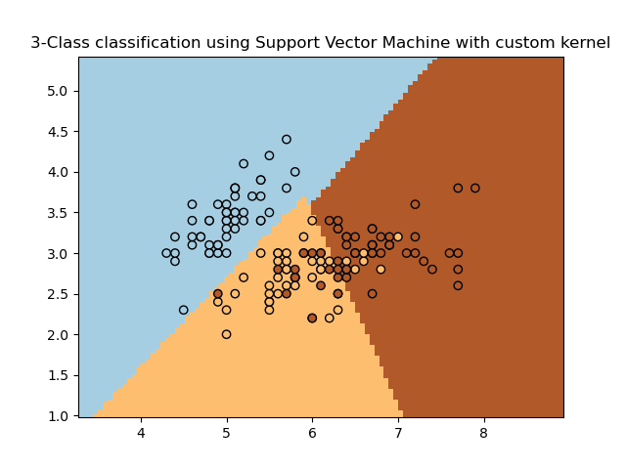
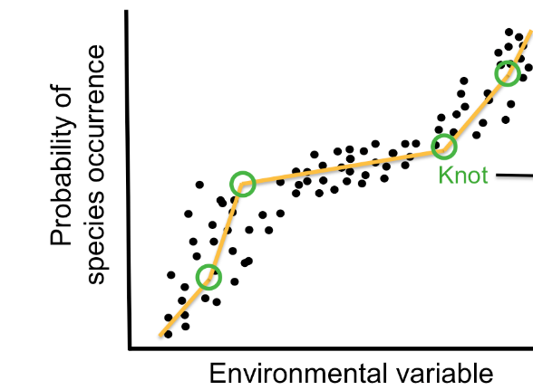
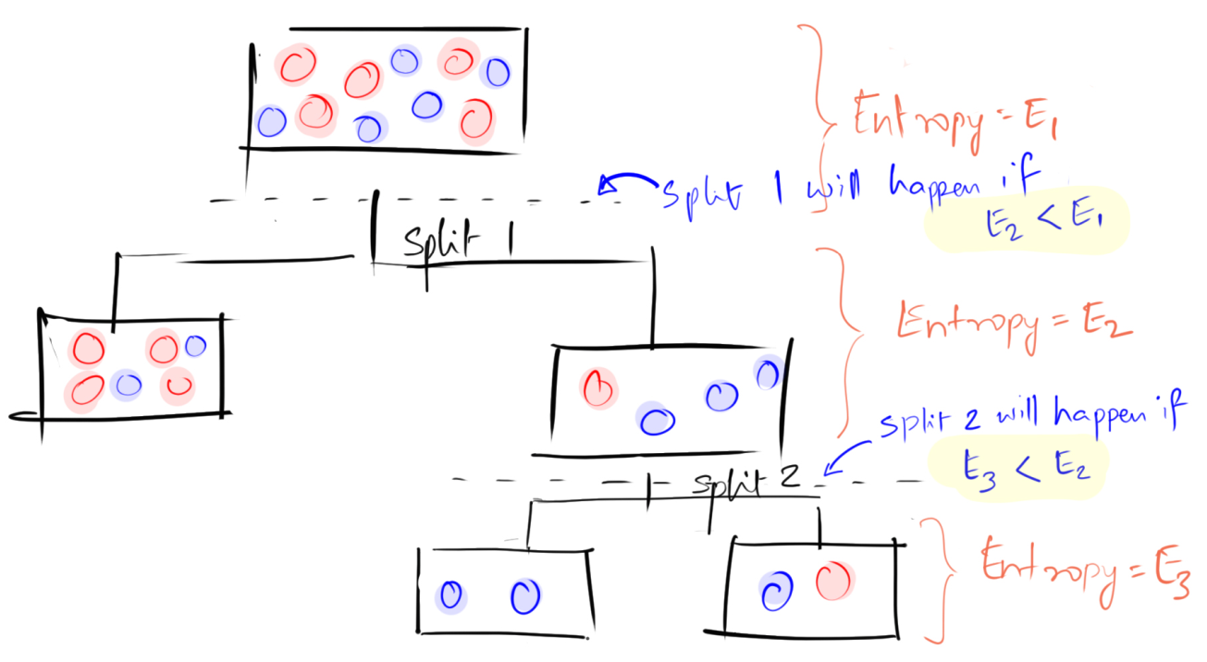
Model selection and Performance Metrics
Models
Support Vector Machines
Random Forest
Multivariate adaptive regression splines (MARS)
These models showed promising result in spatial mapping of soil (Ballabio et al., 2016; Hengl et al., 2018; Liess et al., 2016), landslide hazard (Bui et al., 2016) or atmospheric PM (Choubin et al., 2020).
Outlook -- DNN and GBM algorithms (Peterman et. Al, 2020)

Slide 15
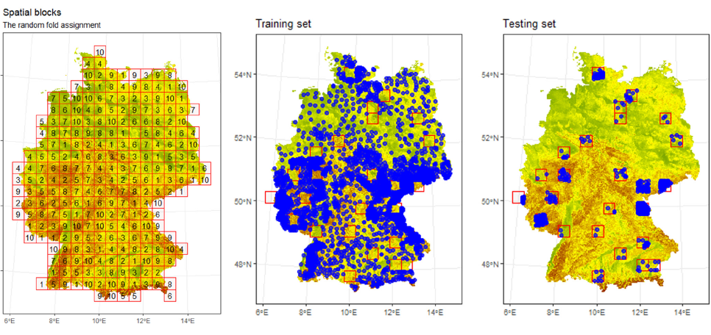
Modelling Strategy
Predictor selection
Removal of collinear and non-informative variables
Building a final model
Hyperparameter tuning
Maximizes the model's performance
Weight(wij) and biases (bij) assigned random values
Mapping (i.e., applying the model for spatial prediction)
Performance assessment
r2, RMSE, MAE, RRSE and RMSLE
Cross validation

Slide 16

Comparing packages between R & Python
Spatial Blocks for CV
Part of Sklearn but require geocoding
VERDE https://www.fatiando.org/verde/latest/gallery/blockkfold.html
Effect of block size (Peterman et. Al, 2020) -- Outlook
MODELS
(MARS) with py-Earth package
Random Forest
Conditional inference trees (CIT) ?
‘https://www.youtube.com/watch?v=vkmd8apKVF8&t=3s’

Slide 17
Targeted Outcome of the study
A completed Masters Thesis
GRP Map (seasonal – as modelled from the given data)
Publication; depend on results
Online interactive visualization of the Maps

Slide 18


